Slide 1
DSCI 531
Dr. Keith Burghardt
Spring 2024

Slide 2
Outline
Course description
Why Fairness and Bias in AI?
Examples of bias in AI
What is ethics?
Course goals
What you will get out of the course
Description of topics
Course details
Contact
Workload
Grading, etc.

Slide 3
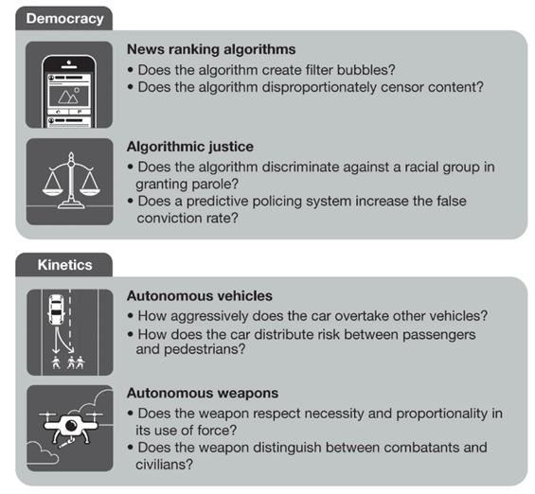
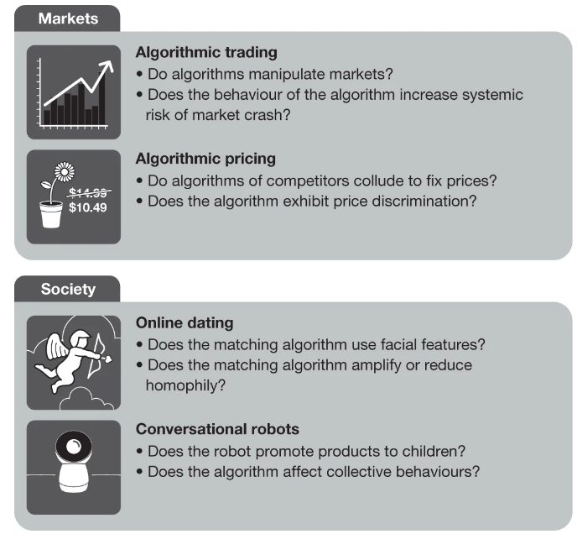
AI is Everywhere
Source: I. Rahwad

Slide 4
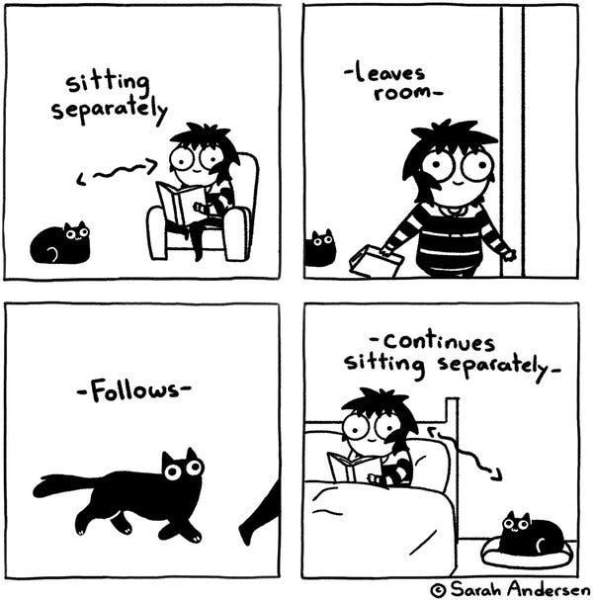
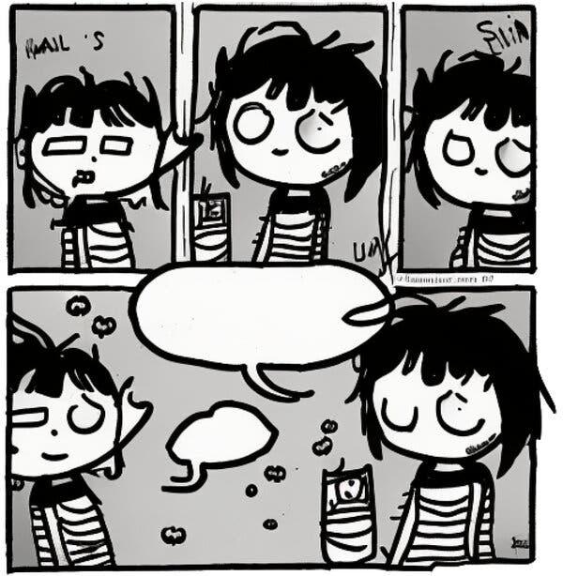
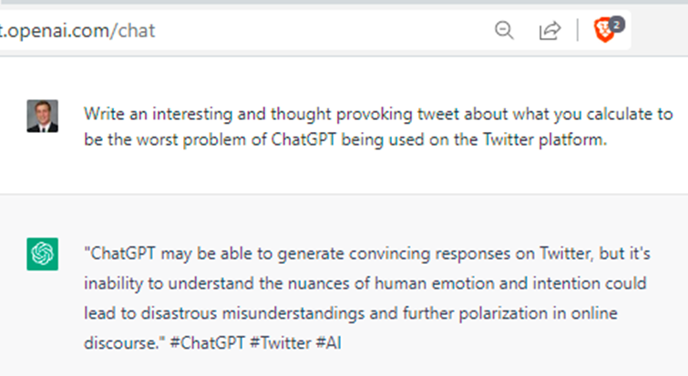
AI is Everywhere: Generative AI
Text generation: GPT3, ChatGPT can generate essays and responses in any style
Image generation: DALL-E, Stable diffusion can generate art in any style
https://www.nytimes.com/2022/12/31/opinion/sarah-andersen-how-algorithim-took-my-work.html

Slide 5

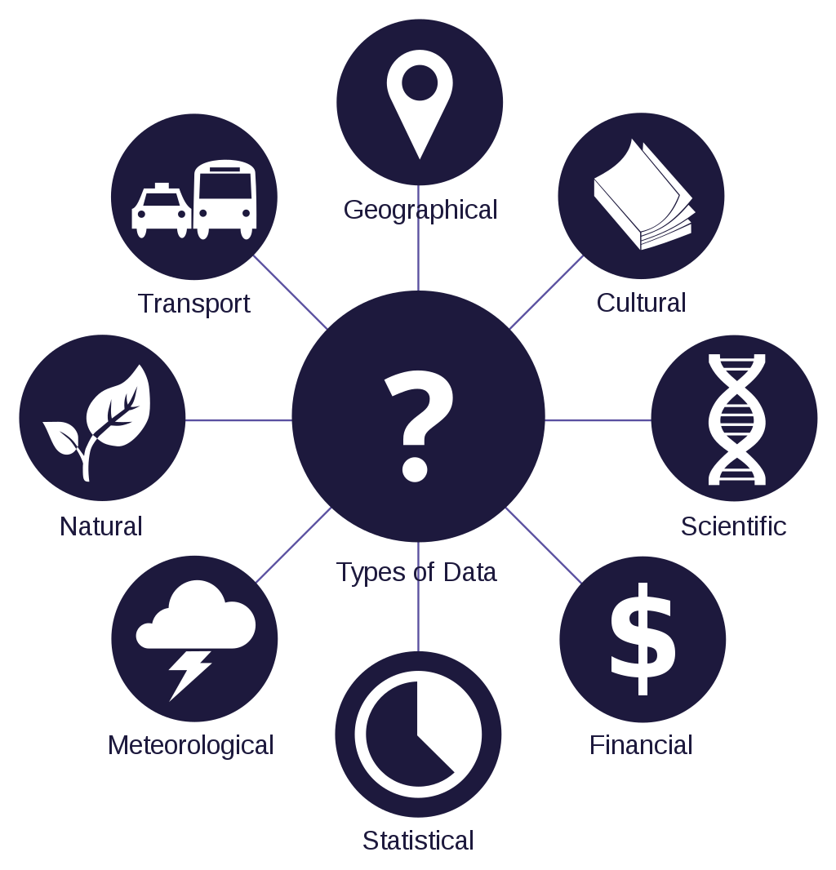

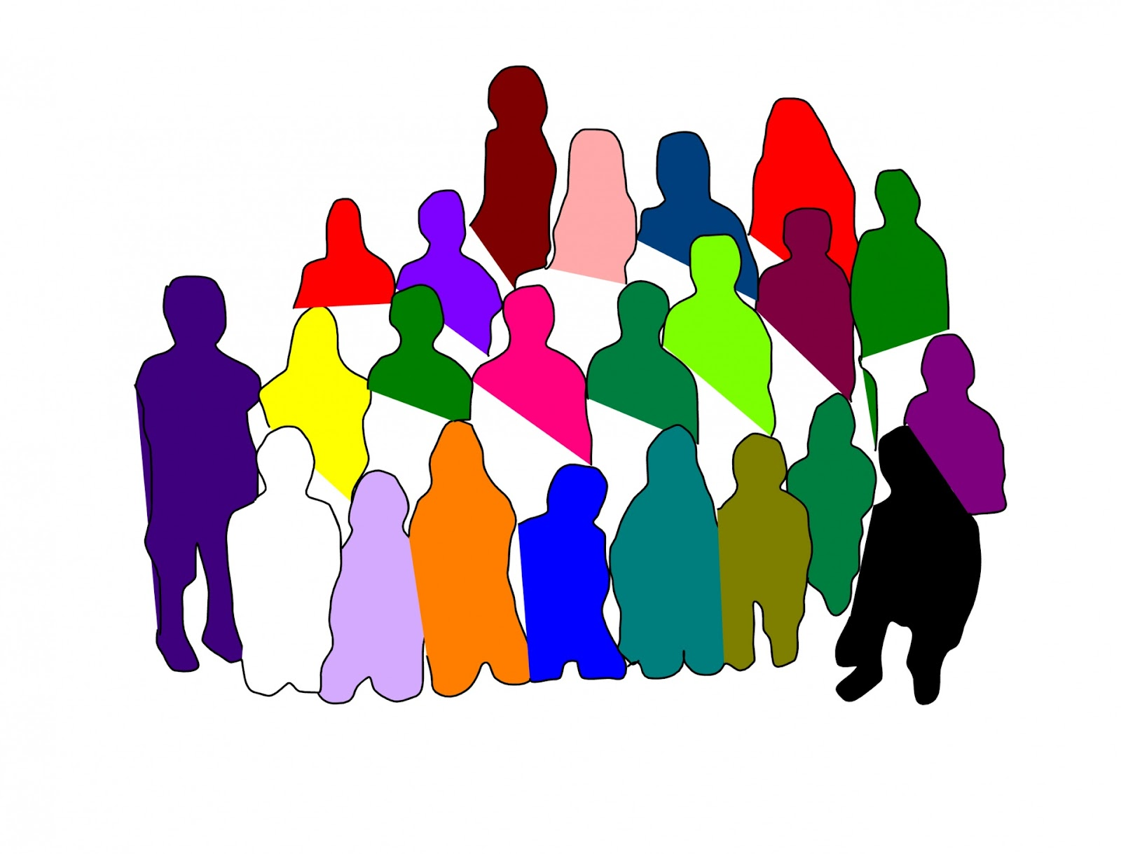
The age of AI: socially embedded algorithms
ground truth data
bring order to the web
never get bored
solve hard problems
make money
massive data
AI algorithms
applications in society
Notes:
Socially embedded AI

Slide 6
The age of AI: what could go wrong?
ground truth data is subjective: noisy & biased
biased
massive data
AI algorithms
applications
applications create more data for AI, creating feedback loops

Slide 7

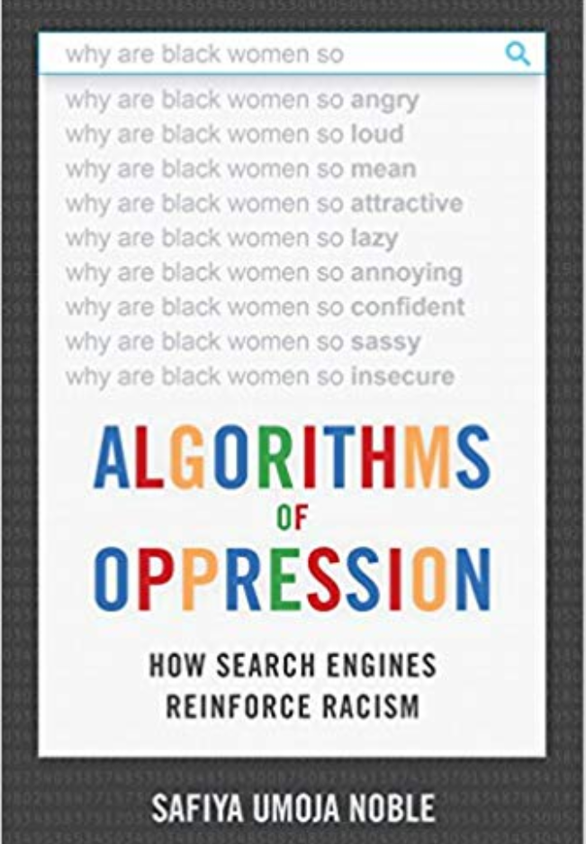
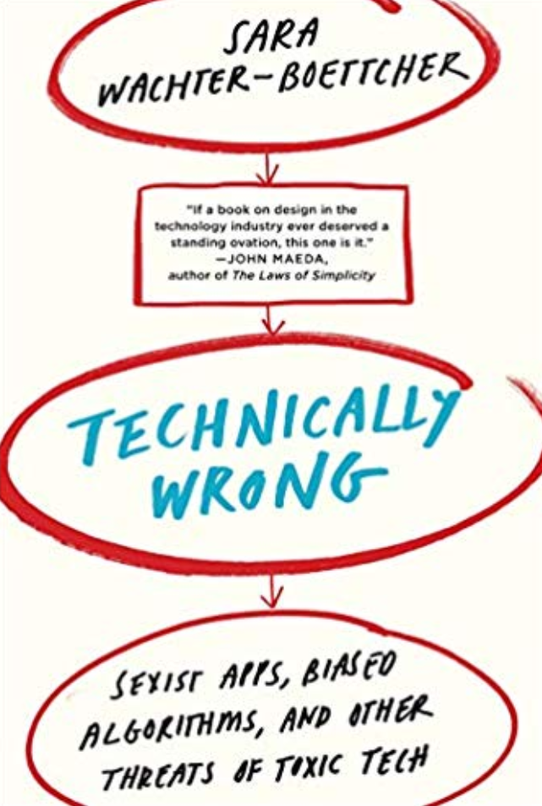
What could go wrong?

Slide 8
Discriminating via AI - some examples

Slide 9
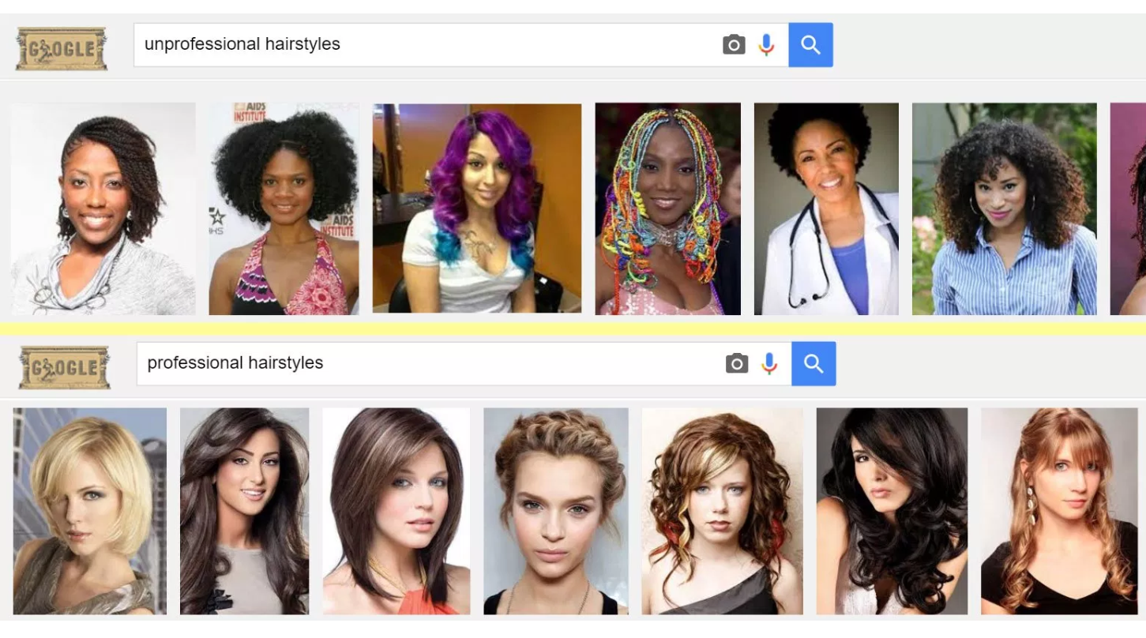
AI and Bias
“Unprofessional hairstyles” vs “Professional hairstyles” in Google image search

Slide 10
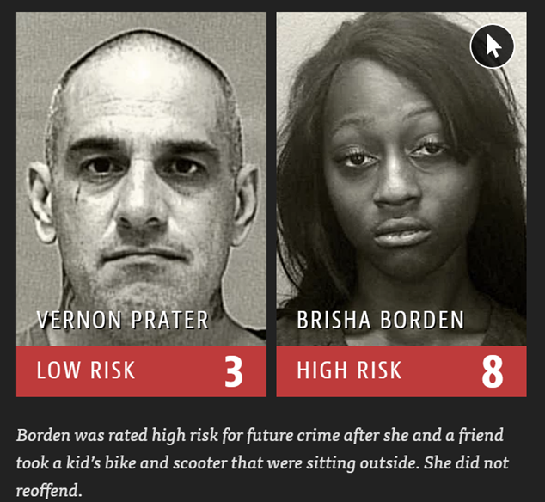
Bias in automated criminal risk assessment COMPAS tool systematically gives black defendants higher risk scores for future recidivism
https://www.propublica.org/article/machine-bias-risk-assessments-in-criminal-sentencing

Slide 11

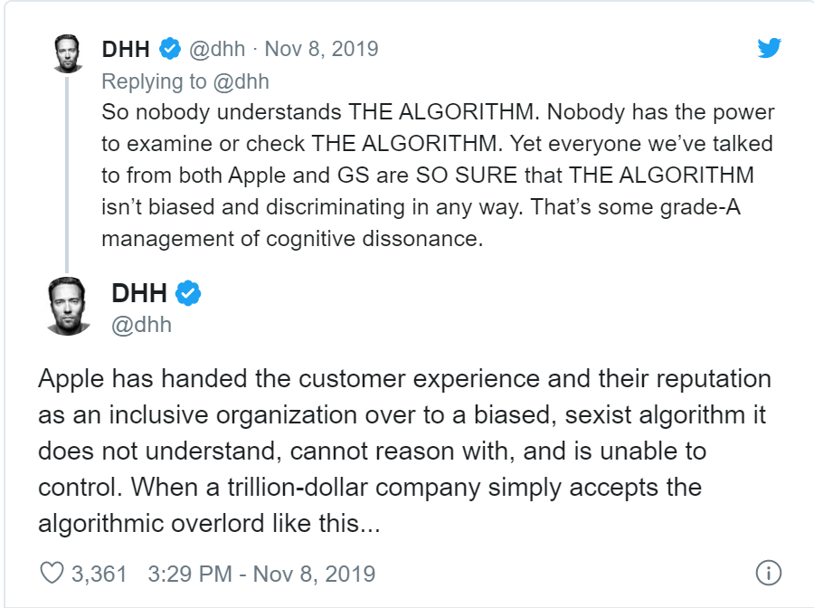

Apple Card Investigated After Gender Discrimination Complaints
A prominent software developer said on Twitter that the credit card was “sexist” against women applying for credit.

Slide 12
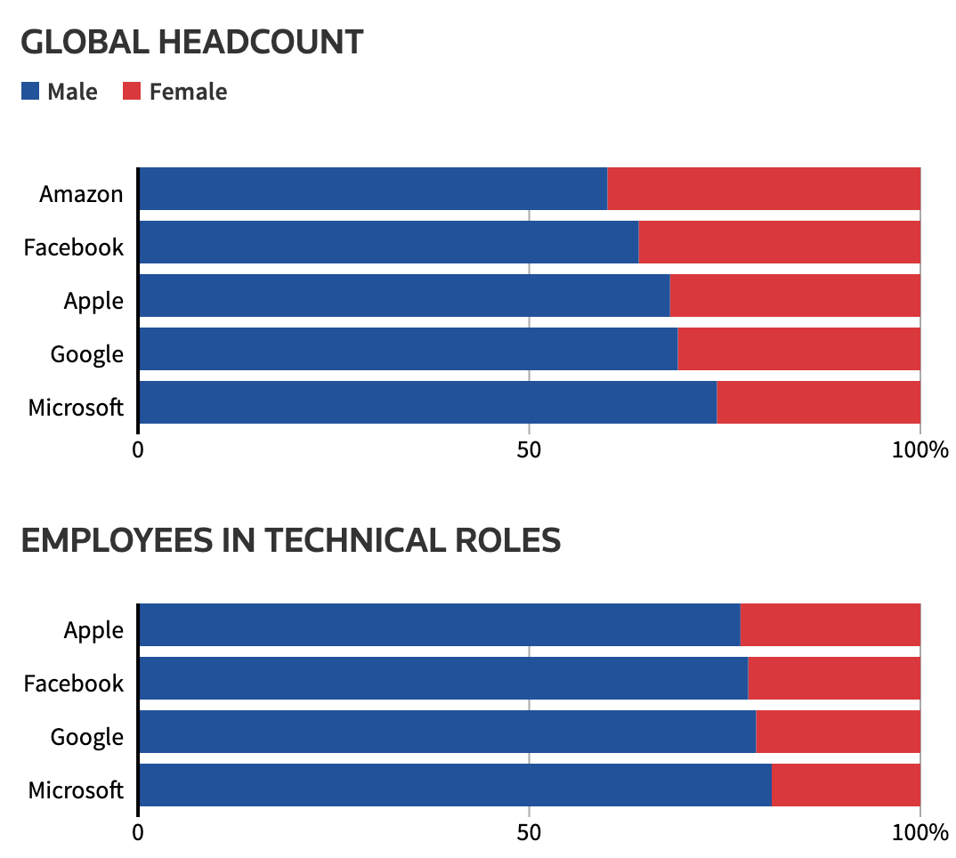
Amazon hiring tool
2014 - Amazon develops AI system to screen resumes.
One year later, realized the screening tool contains gender bias.
Why?
Notes:
(Amazon does not disclose the gender breakdown of its technical workforce.)
Evaluating the algorithm, it was discovered that it dispreferred the word “women’s”, as well as graduates from female-only colleges.

Slide 13
Ethics in AI

Slide 14
What do we mean by Ethics?
What is ethics?
Ethics in the broadest sense refers to the concern that humans have always had for figuring out how best to live
How do we identify a good life, one worth choosing from among all the different ways of living that lay open to us?
Moral principles that govern behavior

Slide 15
What does ethics have to do with technology?
Technology shapes how human beings seek the good life.
Well-designed and well-used technologies can make it easier for people to live well (e.g., by allowing more efficient distribution of food, water, energy, or medical care). Poorly designed technologies can make it harder to live well (e.g., by toxifying our environment, or by reinforcing unhealthy or antisocial habits).
Technologies are not ethically ‘neutral’, for they reflect the values that we ‘bake in’ to them with our design. Technologies both reveal and shape what humans value, what we think is ‘good’ in life and worth seeking.
Technologies are reshaping the global distribution of power, justice, and responsibility
Facebook, Google, Amazon, Apple, and Microsoft have more global political influence than many states and nations.

Slide 16
Technology ethics
The positive and negative impacts of technology are distributed unevenly among individuals and groups.
Technologies can create widely disparate impacts, creating ‘winners’ and ‘losers’ or magnifying existing inequalities, e.g., when benefits of a new technology are enjoyed only by wealthy nations while the burdens of environmental contamination produced by its manufacture fall upon citizens of poorer nations.
How do we ensure that access to the benefits of new technologies, and exposure to their risks, are distributed in the right way? This is a question about technology justice, a matter of ethics.

Slide 17
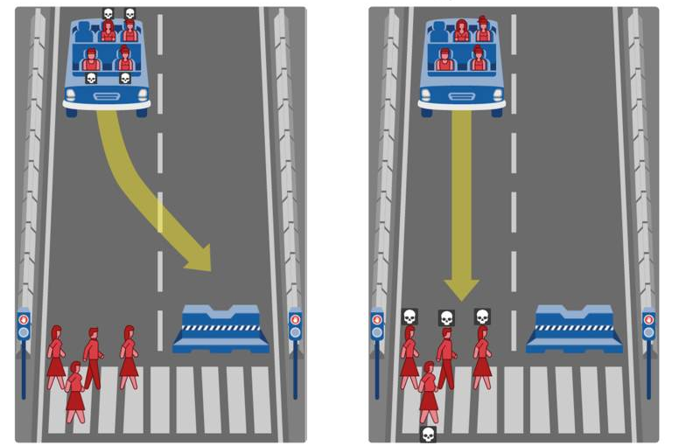
What should a self-driving car do?

Slide 18
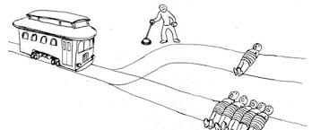
AI and ethics
The Trolley problem
You see a runaway trolley moving toward five tied-up people lying on the tracks. You are standing next to a lever. If you pull the lever, the trolley will be redirected onto a side track, and the five people on the main track will be saved. However, there is a single person lying on the side track. You have two options:
Do nothing and allow the trolley to kill the five people on the main track.
Pull the lever, diverting the trolley onto the side track where it will kill one person.
Which is the more ethical option?

Slide 19
Other ethical dilemmas
AI infers gender
ads for high-income jobs are presented more often to men than to women
AI infers race
ads for arrest records are significantly more likely to show up on searches for African-American names
AI infers a person’s income
Alternative 1: provides better product recommendations
Alternative 2: uses the information to set product prices
AI infers a person’s health state
Alternative 1: recommends lifestyle changes to improve health
Alternative 2: uses it to set health insurance rates
AI directs our interactions
recommendations for friends, and news articles that further biases

Slide 20
Legally problematic when harm protected classes
US Federal laws define protected classes to include:
Race.
Color.
Religion.
National origin or ancestry.
Sex/Gender.
Age.
Physical or mental disability.
Veteran status.
Genetic information.
Citizenship.
But other types of bias exist… (fat bias, physical attractiveness, …)

Slide 21

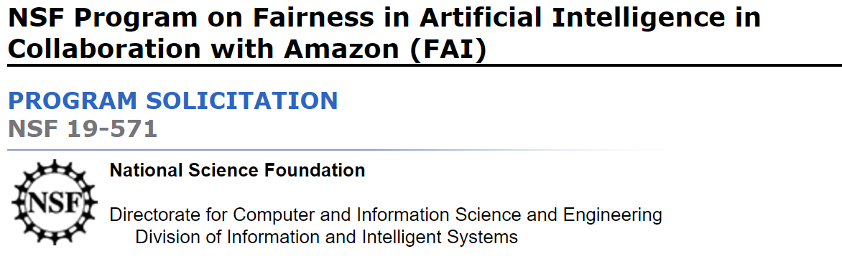

Increasing interest in AI fairness

Slide 22
Overview of topics

Slide 23
What is fairness?
Intuitive property of fairness
Your private attributes (race, gender, …) should not affect how you are treated by the algorithm (esp. when they are not relevant to the decision being made)
In reality, dozens of measures of fairness,
Many incompatible with each other and can only be simultaneously satisfied in a few special cases.

Slide 24
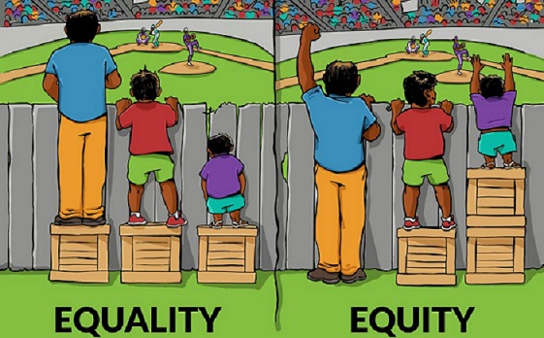
Fairness and equity

Slide 25
This course at a glance
Data
Language
Fairness & Bias
Images
Networks

Slide 26
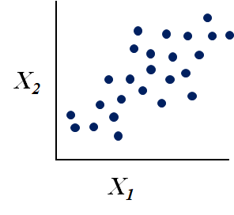
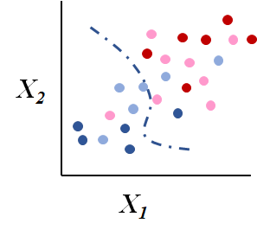
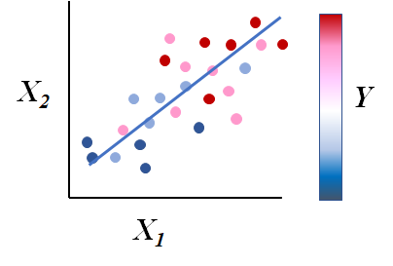
Types of data analysis methods
Unsupervised methods
Input: a set of features
Clustering
K-means, hierarchical, spectral,
Dimensionality reduction
PCA, SVD, …
Supervised methods
Input: features & labels/outcomes
Classification
Random forest, SVM, …
Regression
Linear regression, logistic …

Slide 27
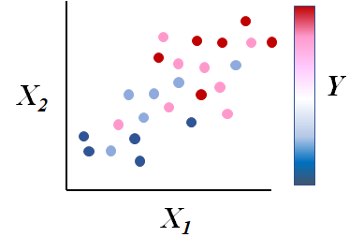
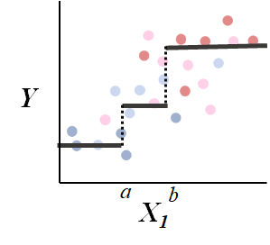
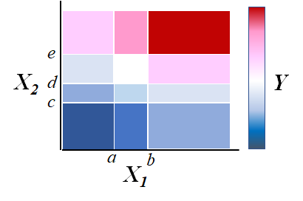
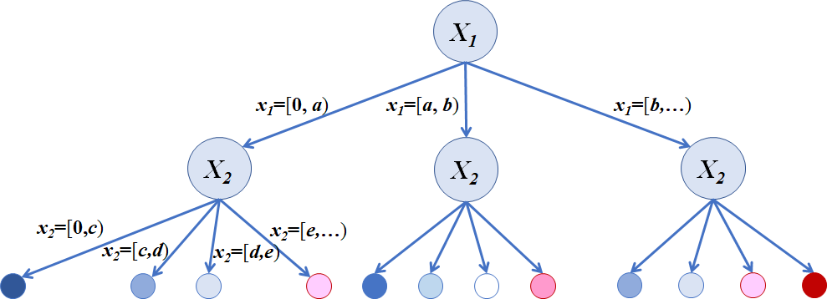
Data modeling and prediction

Slide 28
Evaluation
How well does a model work?
Testing simple models
Train on part of the data, test on held-out data
Testing data has labels (ground truth)
Repeat k times on random samples
k-fold cross validation
Testing complex models
Some models require parameter tuning
Train on part of the data
Tune on separate data
test on held-out data
Measure performance on test data
Accuracy, precision/recall, F1, ROC, AUC

Slide 29
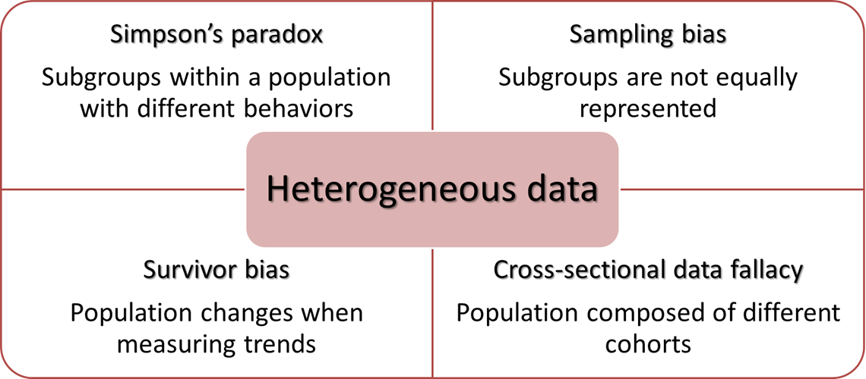
Sources of bias in data

Slide 30
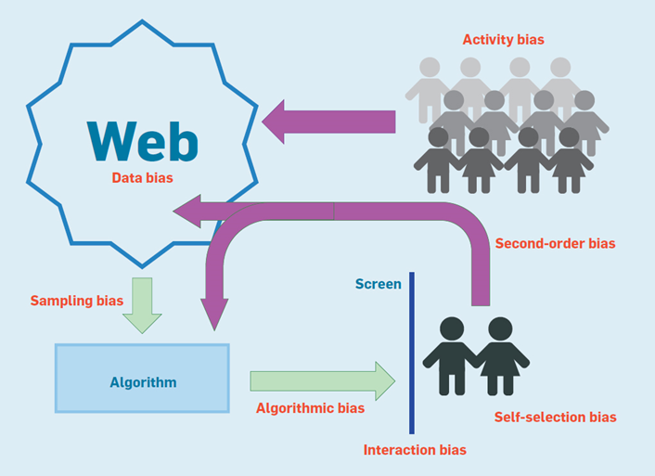
Sources of bias in social data

Slide 31
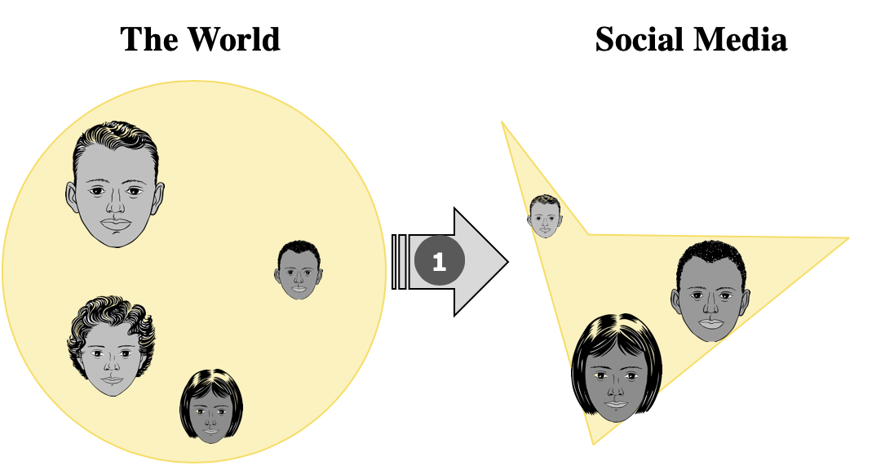
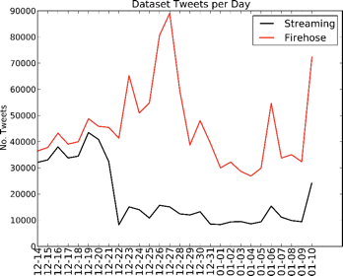
Sampling and Representativity

Slide 32
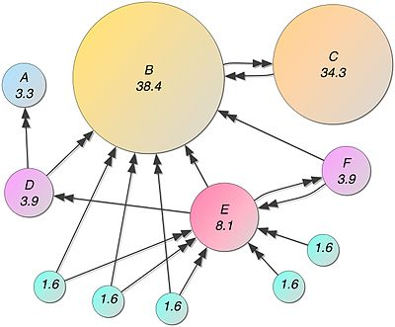
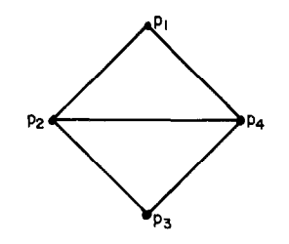
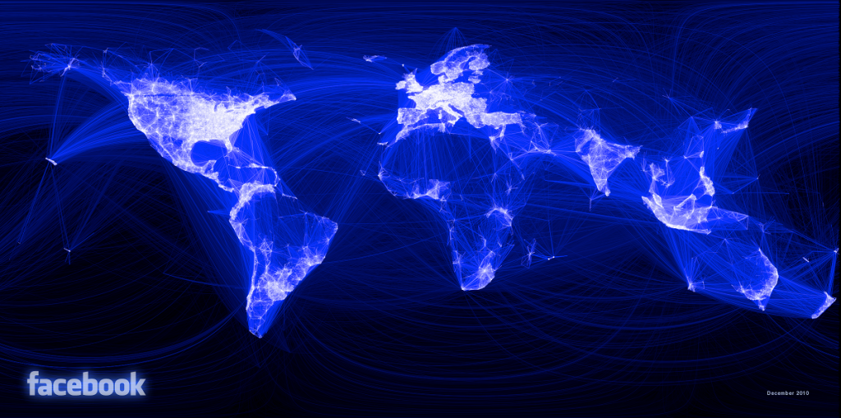
Networks: Representation and Metrics

Slide 33
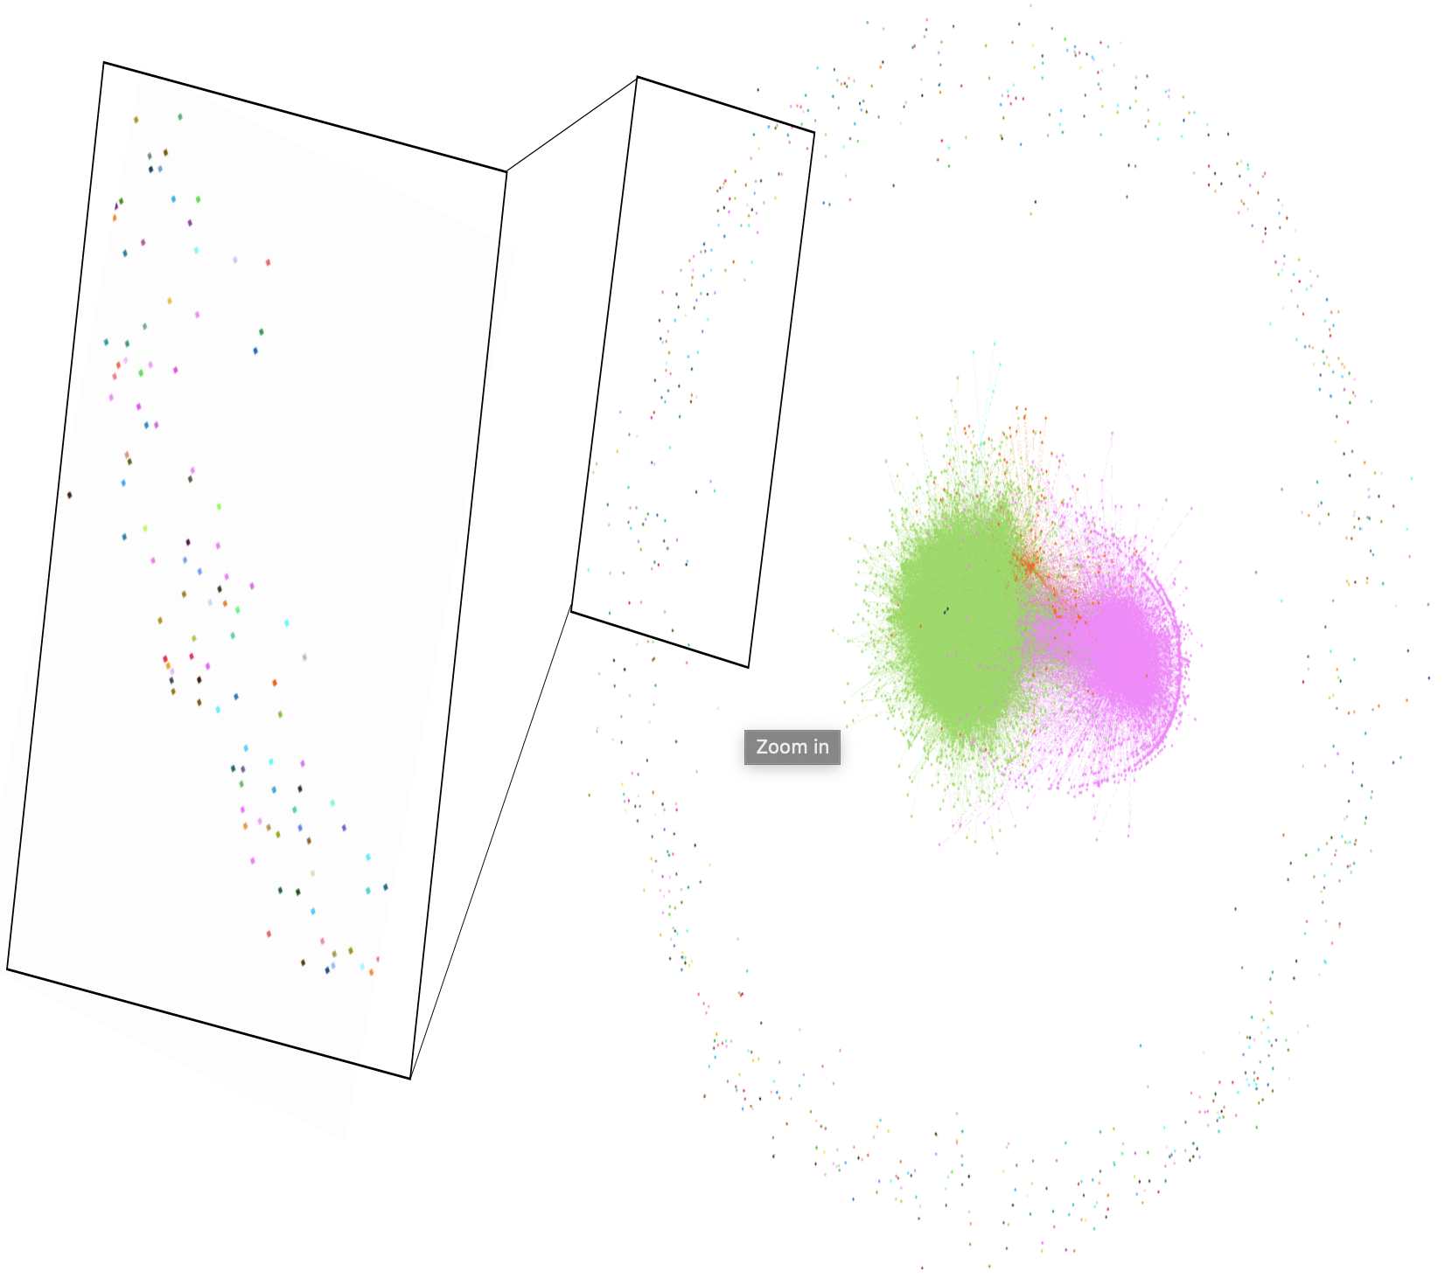
Fairness in Community Detection

Slide 34
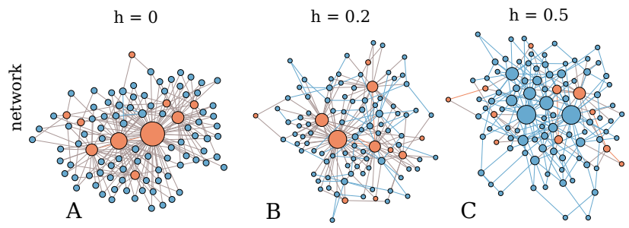
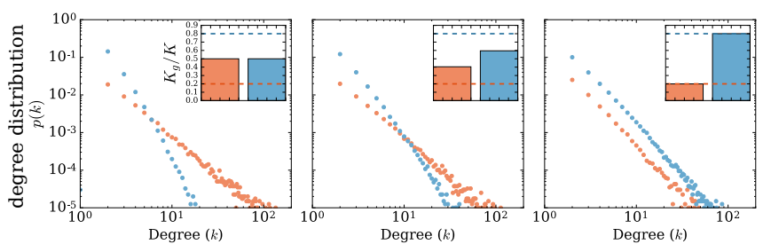
Ranking bias in networks

Slide 35
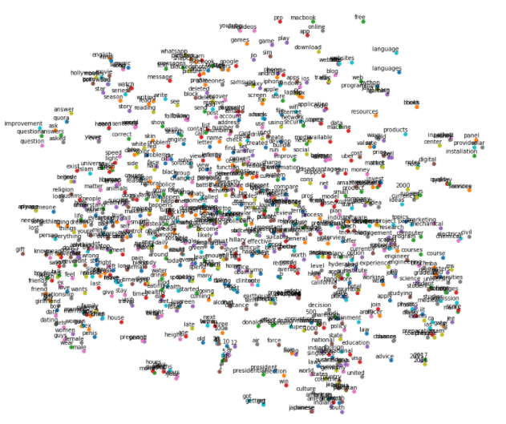

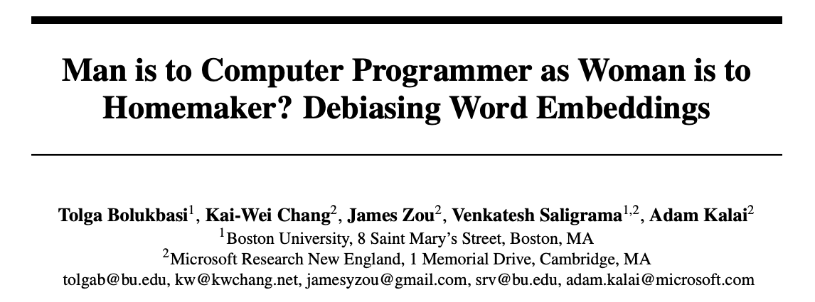
Fairness in language
Word Embeddings

Slide 36
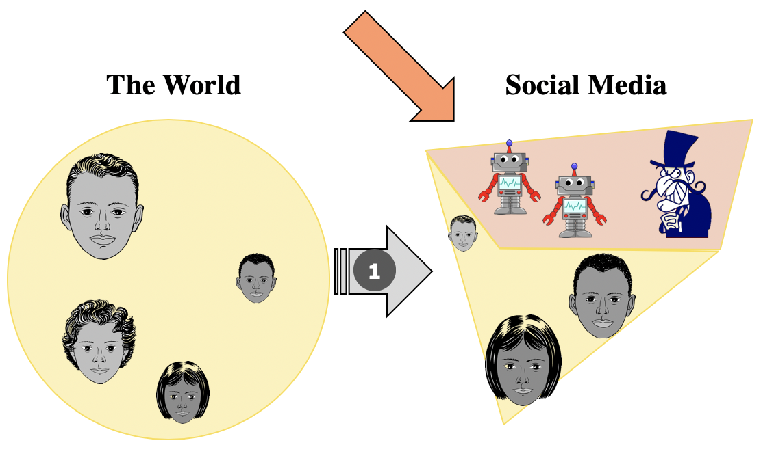
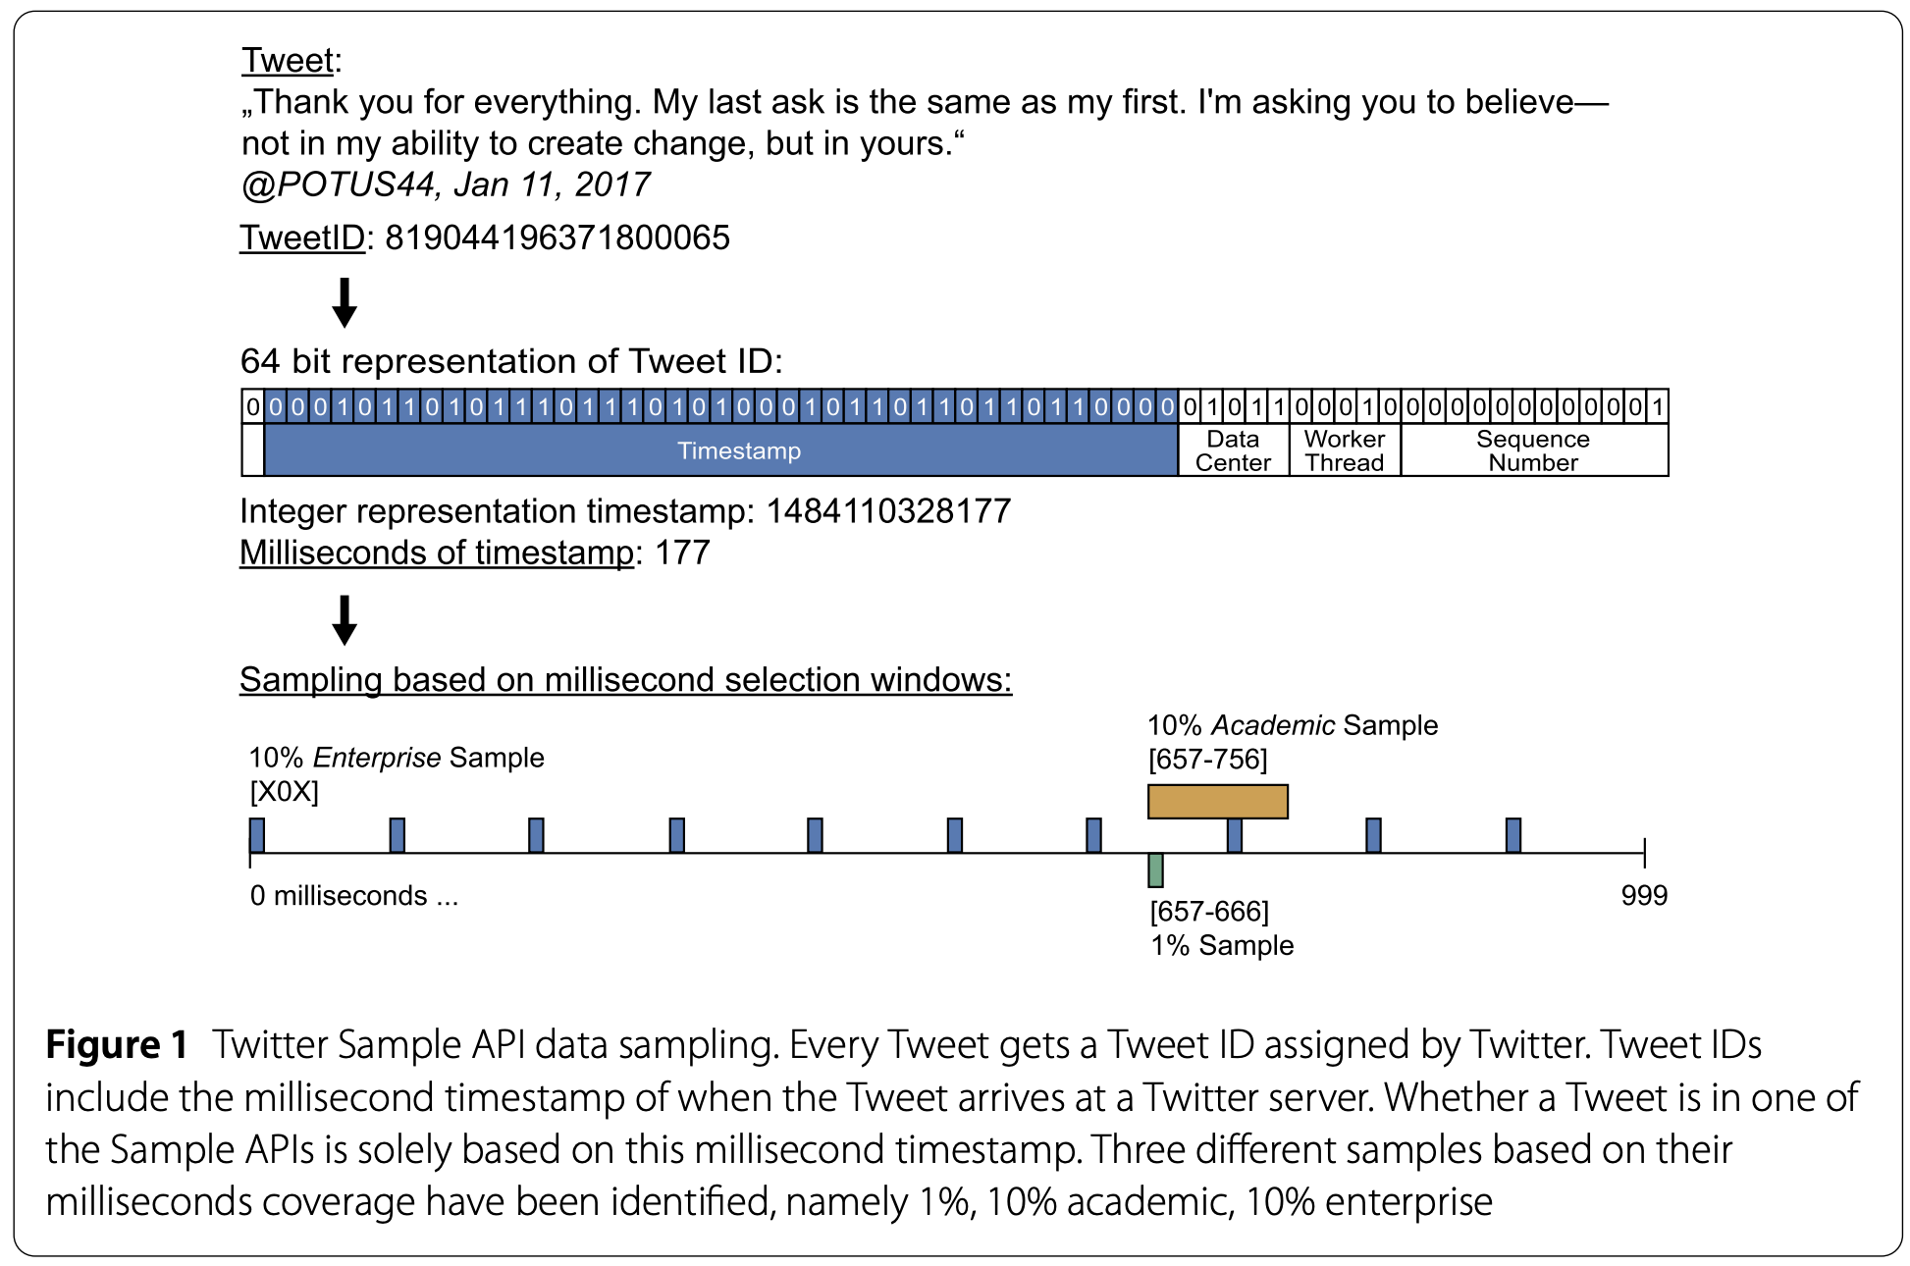
Manipulation and Deception

Slide 37
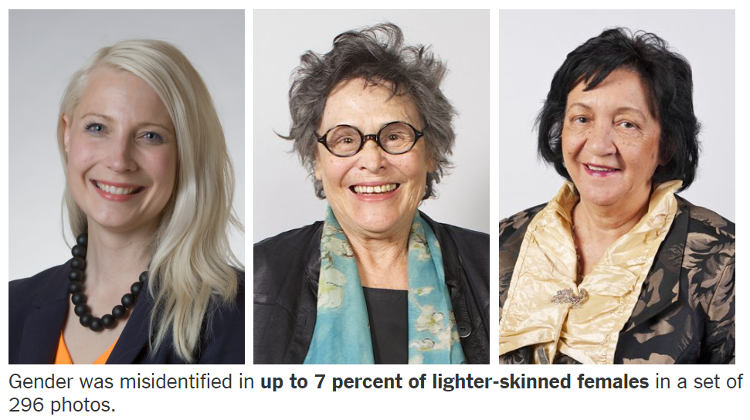
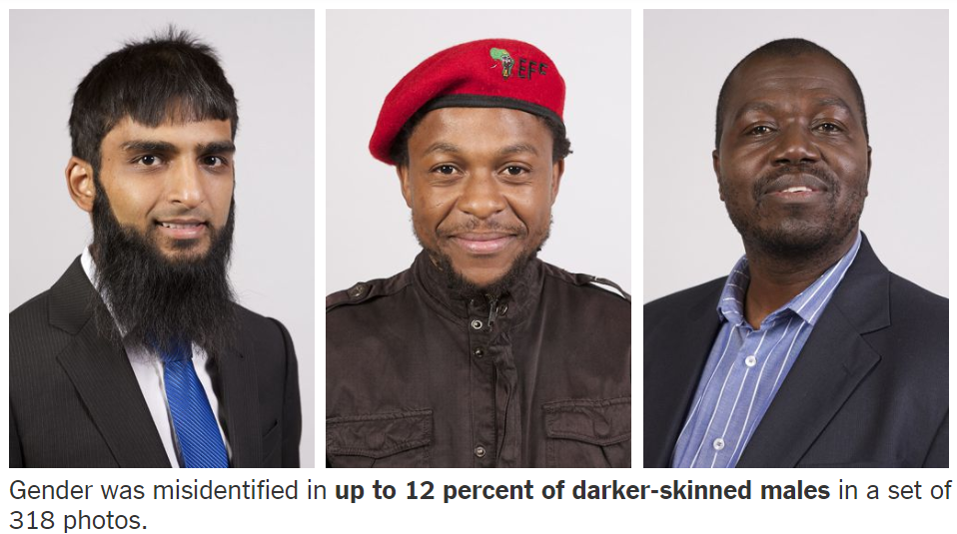
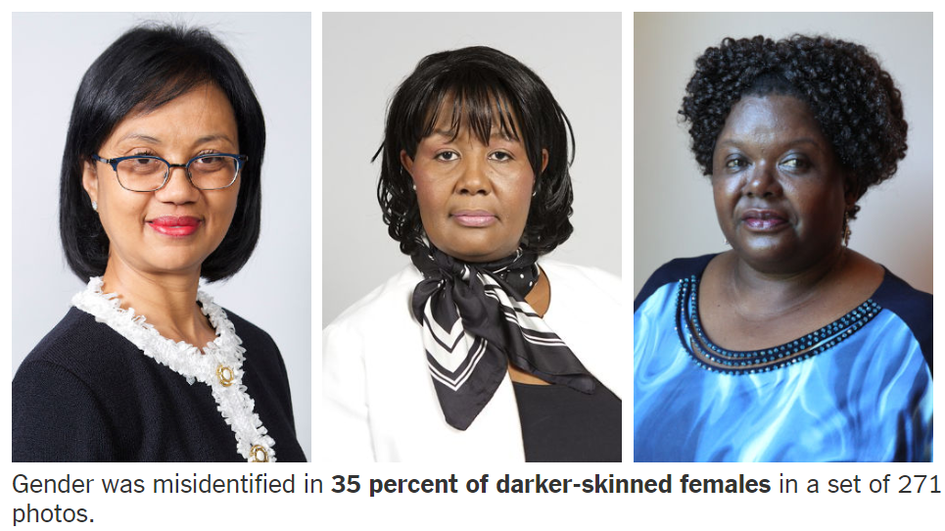
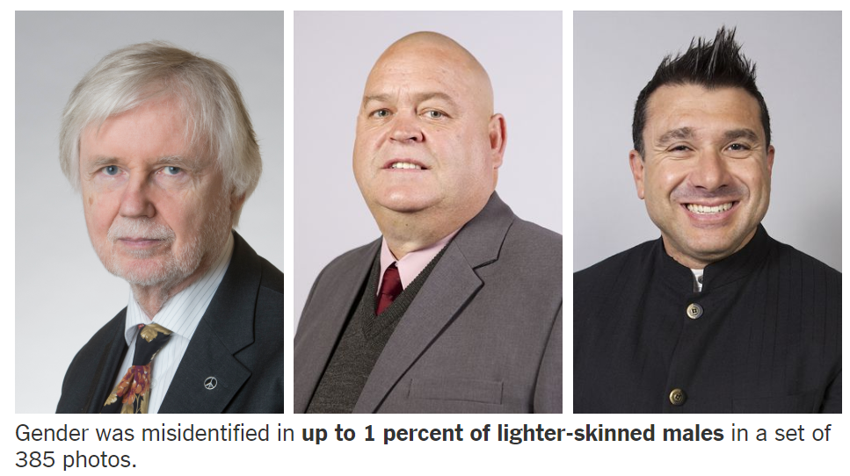
Fairness in image analysis: Gender classification error rate
https://www.nytimes.com/2018/02/09/technology/facial-recognition-race-artificial-intelligence.html

Slide 38
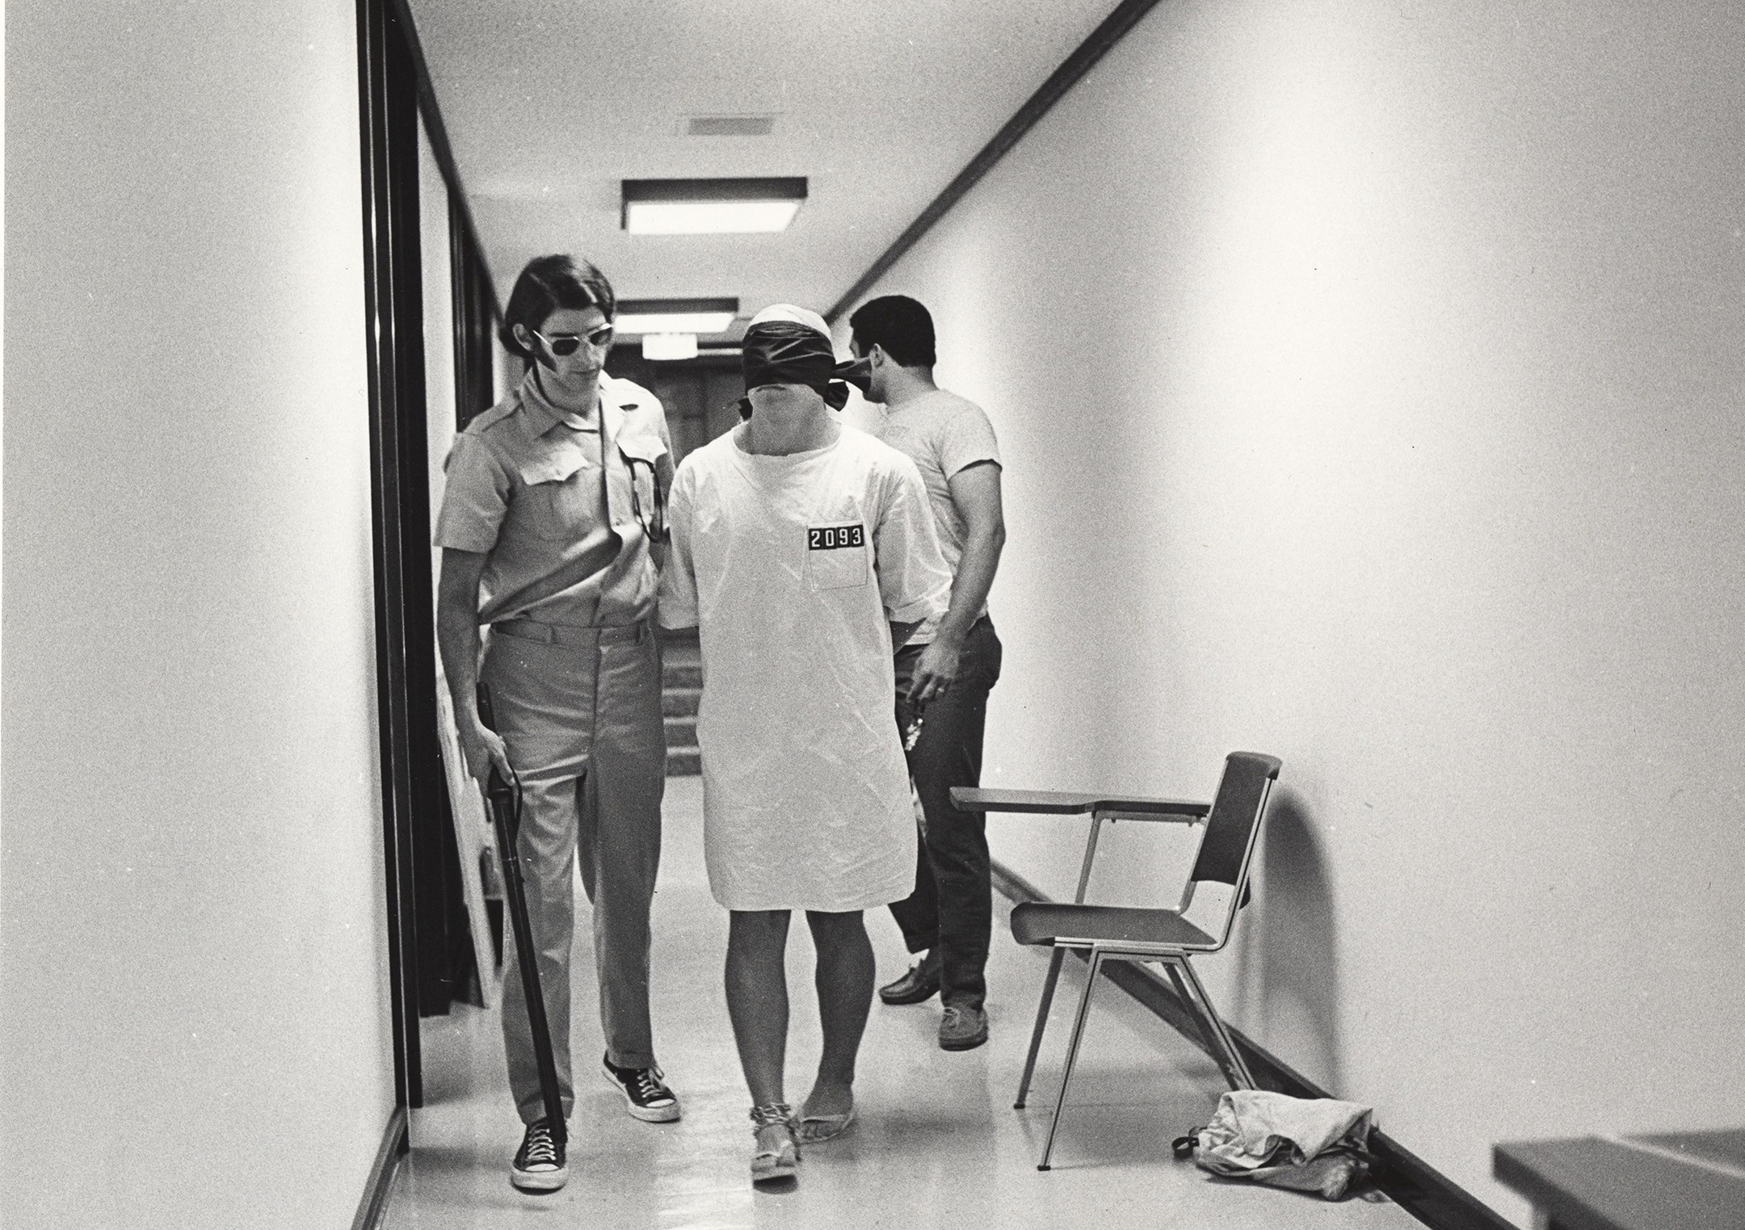

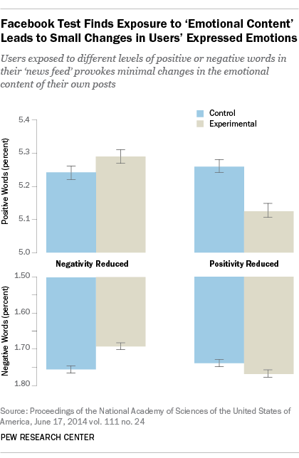

Ethics in Research
History and Ethical Principles
Defining Research with Human Subjects
Internet-Based Research

Slide 39
What you will get out of the course
Learn the principles of data science, and how to use them responsibly
Social data
Networks
Language
Learn how to create explainable and transparent models
not black box methods!
how to avoid common pitfalls of analysis
Apply what you learn to an original research project
Learn to present research findings, and learn from peers

Slide 40
Course details

Slide 41
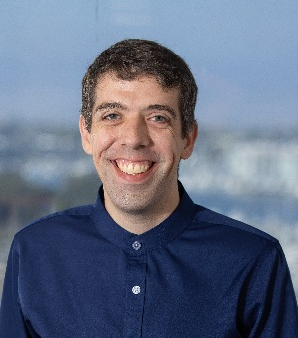
Where to find me (Keith Burghardt)
At USC
Immediately before or after class
At ISI
ISI Rm. 940 (by appointment)
Zoom (by appointment)
Email: keithab@isi.edu
About me: https://www.kburg.co/

Slide 42

TA
Fiona Guo
Office: ISI 921 OR https://usc.zoom.us/my/siyiguo
Office Hours: 10-11 Wednesday on Zoom or by appointment
Contact Info: siyiguo@isi.edu

Slide 43
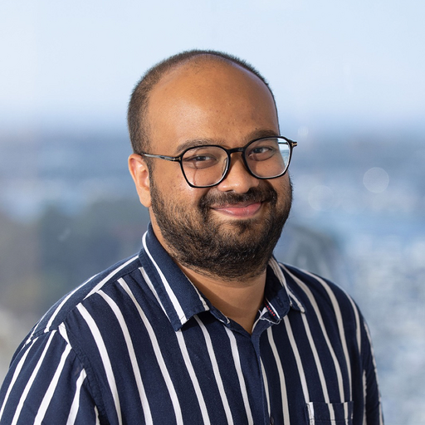
TA
Ashwin Rao
Office: ISI 911 OR https://usc.zoom.us/j/9026240639
Office Hours: 10AM - 11AM PT Monday on Zoom or by appointment
Contact Info: mohanrao@usc.edu

Slide 44
Course Communication
Blackboard – blackboard.usc.edu
Your USC login works on this account
If you are registered for 531, you will have access
All assignments will be submitted through Blackboard
Slack
logistics (#general)
Piazza (preferred)
https://piazza.com/usc/spring2023/dsci531
important announcements
logistics
course discussions
homeworks
All questions should be posted (not emailed!)
If you know the answer to a posted question, please try to provide helpful suggestions

Slide 45
Readings
Posted on the site each week
You can read it online or print them
Listed in syllabus (subject to change)
Please read all required readings before the class they are covered

Slide 46
Slides
•Available online before the lecture
•NOT a replacement for the lecture
•You can print these out and make notes on them

Slide 47
Prerequisites & Recommendations
Prerequisites
Working knowledge of Python
Recommended courses a plus
Recommended Courses
CS561 – Introduction to AI
CS573 – Advanced AI
DSCI551 – Data Science
Probability and statistics
Networks or Graph Theory, NLP

Slide 48
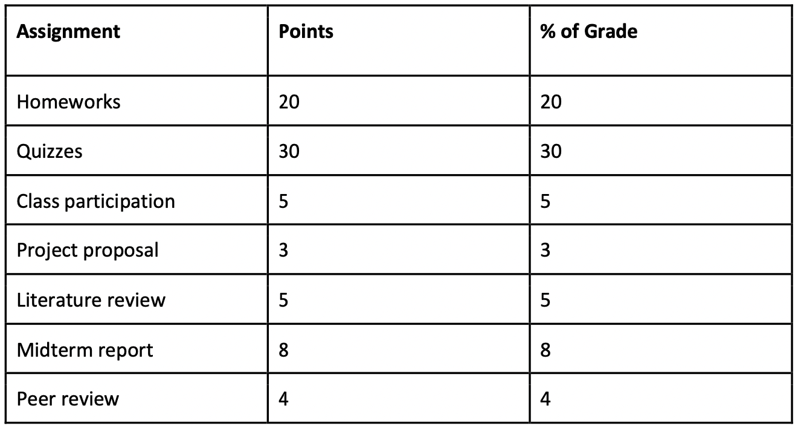
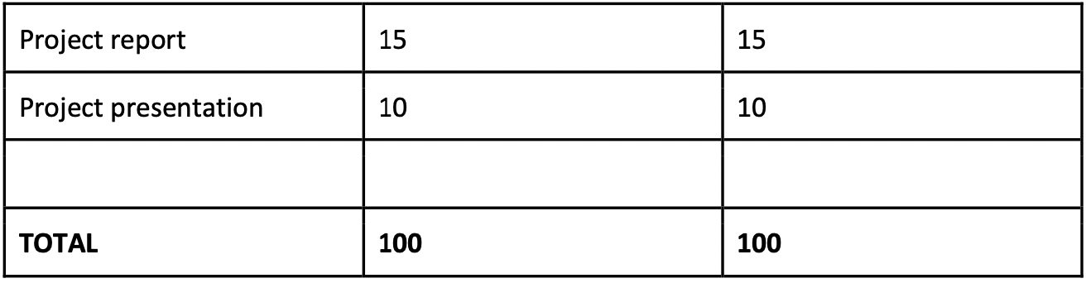
Grading

Slide 49
Workload - class participation
Importance – 5% of the final score
Easiest points to receive
Show up to class
Do not use social media in class …
Answer questions
Ask questions

Slide 50
Workload - Homework
Importance – 40% of the final score
Timeline
HW #1: Research ethics
Due 1/17
HW #2: Bias in Data and Prediction
Due 2/7
HW #3: Bias in NLP
Due 2/28
HW #4: Bias in Networks
Due 3/20
Grading rubric: see syllabus

Slide 51
Workload - Quizzes
These are worth 30% of your final score
Importance
5 quizzes, roughly every other Monday in class
Basic ideas discussed in the class and/or the topics related to the recommended readings
Your lowest score will be dropped

Slide 52
Workload - Projects
Importance – 35% of the final score
Grade breakdown
Proposal: 3%
Due 2/29
Literature Review: 5%
Due 2/21
Mid-term Report: 8%
Due 3/25
Peer Review: 4%
Due 4/3
Final Presentation: 10%
4/22 and 4/24, in class
Final Report: 15%
Due 5/3

Slide 53
Grading policy – Late days
7 days combined
4 homework assignments and 5 course project assignments (proposal, lit review, midterm report, peer review, final report)
No late days allowed for quizzes
Max 2 days for each submission
Submissions after 2 late days or when 7 late days are used up will lose 20% points per day.

Slide 54
Course Project
A research project based on what you have learned in class
Be creative!
An ideal project is one that you could publish a paper about
Empirical validation is important – show that your method beats state-of-the-art
Teaming
2 students
No individual projects

Slide 55
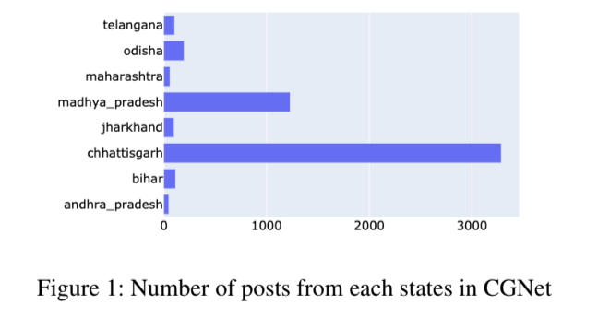
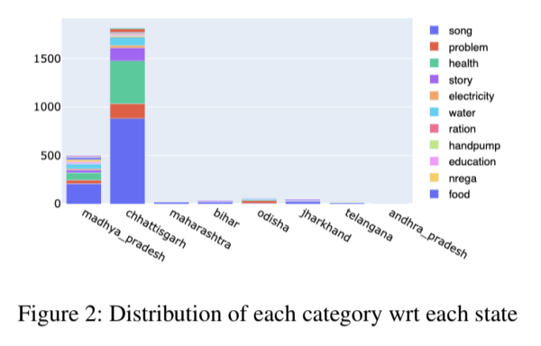

An Extensive Analysis of Exclusion Bias through Social Media

Slide 56


Unfair Fairness Evaluation

Slide 57



Regional Ageism in Traffic Policing Activity

Slide 58
(Example!) Data sets
Social data
Harvard Dataverse
https://dataverse.harvard.edu/
Online networks/social media
SNAP http://snap.stanford.edu/
Education
https://pslcdatashop.web.cmu.edu/
COMPAS Dataset: https://github.com/propublica/compas-analysis/
Diversity in Faces: https://www.research.ibm.com/artificial-intelligence/trusted-ai/diversity-in-faces/
UCI Adult Dataset: https://archive.ics.uci.edu/ml/datasets/Adult

Slide 59
Project Proposal
Proposal should include:
Title
This should be the title of your final paper
Authors
The people who will be involved in the project
A description of the project
Be sure to state what you think is new and innovative about your project
The use of pictures and screen shots is encouraged
The date you would like to present your project
Length – 2 pages (max)
Format: Latex

Slide 60
Project Paper
Due at the beginning of the last class
Length: 5 pages
Format: Latex – same as project proposal
use overleaf.com
Content:
Title block
Abstract
Body
References

Slide 61
Project paper: Title Block
Title of the paper
Choose a title that highlights the contribution of your paper
Keep it short (<16 words)
Title should summarize the main outcome of the study
Full names of the authors
Address includes affiliation:
University of Southern California
Computer Science Department
Los Angeles, CA 90089
Your email address

Slide 62
Project paper: Abstract
An abstract is a 100-250 word summary of your paper
Identify the problem you are solving
Describe your solution
Summarize the results that support your solution
An abstract is NOT the same as the introduction
NEVER repeat the abstract in the introduction
You might restate portions of it in the paper, but using different words

Slide 63
Project paper: Introduction
Introduction is a Mini Paper
The formula
The problem and why is it important
State of the art and its failing (~Related Work)
Your contribution (~Methods)
Its benefits (~Results)
End with the big picture (~Conclusion)

Slide 64
Project paper: Body of Paper
Introduction
Sections might include:
Motivating application or example
Approach or Methods
Results or Evaluation
Evaluation is one of the most important components of the paper!
Related work
Conclusion/Discussion
Summarizes the contribution, including any conclusions and directions for future research
Use pictures, screen shots, and diagrams

Slide 65
Project paper: References
References to both related work and work that you build on
Use the “named” bibliography style [Ambite, 2004].
Bibliography
Ambite, Jose Luis, 2004. Planning by Rewriting, Journal of Artificial Intelligence, Kluwer Academic Publishers, 4(2), pg 27—34.

Slide 66
Cheating and academic integrity
Not tolerated!
No second chances – all infractions will be reported
First offense is automatic failure in the class
Second offense is suspension from the University
Examples:
Turning in someone else’s work
Copying from someone else during a quiz
Doing a project that uses someone else’s work without giving them credit
We will follow USC policies: https://sjacs.usc.edu/students/academic-integrity/

Slide 67
Plagiarism is cheating
What is plagiarism?
More than 7 words copy and pasted from another work
But what if I want to quote someone verbatim?
“put it in quotes and reference” (K. Lerman, Course Introduction, p. 72, 2023)
Examples
Copying text or figures from someone’s paper
Copying text from a blog and passing it off as your own work

Slide 68
Rules of behavior
Attendance
Please be on time
Phone use
If it makes noise, turn it off or to vibrate mode in class
No texting! No web surfing!
Pay attention! You are paying for the privilege of attending the course – make the most of it

Slide 69
Once the course is over
Directed research (1-2 MS or Phd Students)
Research Assistantships (Phd Students)
We can also recommend you for positions in other groups
Teaching Assistantships (for PhD students)

